Slide 1
Africa the dark continent?
A political Economic Analysis of Africa’s Development Issues
Presenter: 江德曼
Thiombiano Dramane
2018/09/21

Slide 2
Outline
Introduction
Representation of Africa in the International System
Africa, the dark continent?
Q & A

Slide 3
Introduction
Africa is a continent of 54 countries states, 9 territories, 2 de facto independent states with limited or no recognition
World second largest and second most populous continent
1.2 billion people, 16% of the world human population
Young population, median age is 19.7 (2012) - 30.4 for the worldwide median age.

Slide 4
Introduction
Algeria is its largest country by area and Nigeria is its largest by population
Cradle of humanity (East Africa)
Hosts large diversity of ethnicity
African Union (Addis Ababa)

Slide 5
Biggest Cities in Africa
Lagos, Nigeria – 21 million.
Cairo, Egypt – 20.4 million. Cairo is Egypt's largest city and its capital.
Kinshasa, DR Congo – 13.3 million.
Luanda, Angola – 6.5 million.
Nairobi, Kenya – 3.5 million People.
Mogadishu, Somalia – 2.1 million people.
Abidjan, Ivory Coast – 4.707 million.
Alexandria, Egypt – 4.7 million.

Slide 6
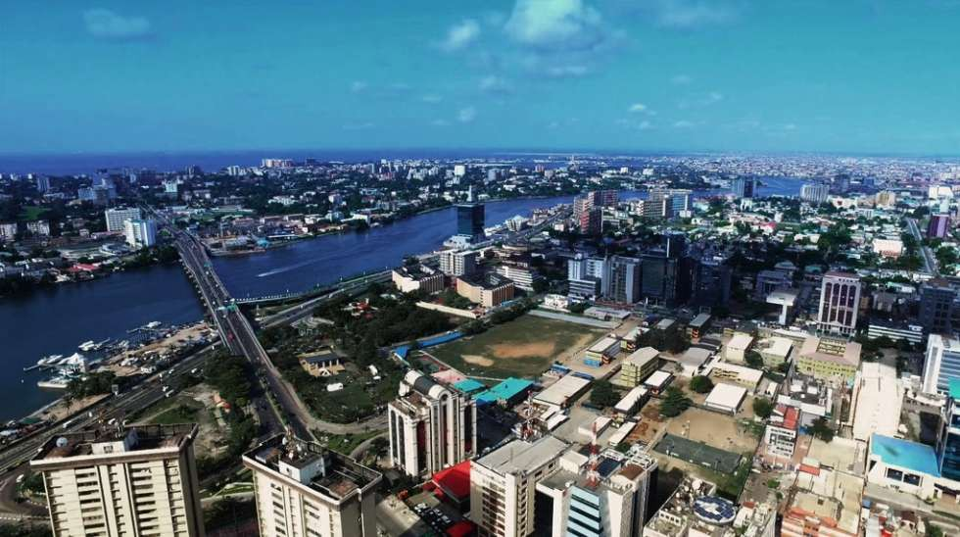
Lagos
Africa the dark continent?

Slide 7
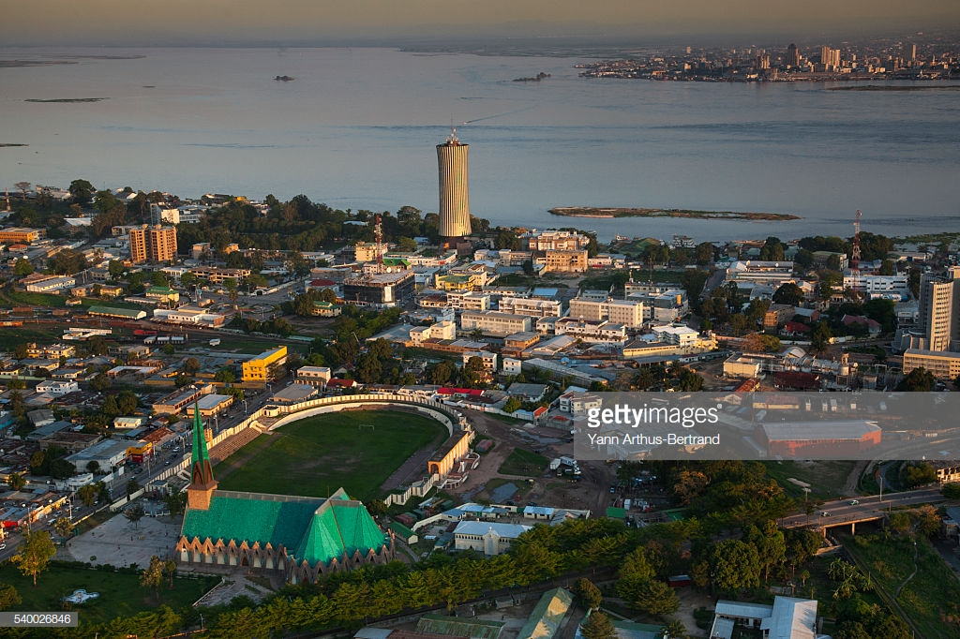
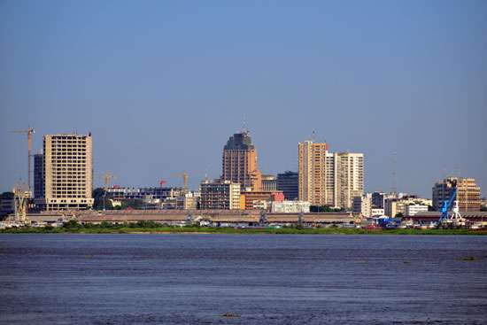
Lagos

Slide 8
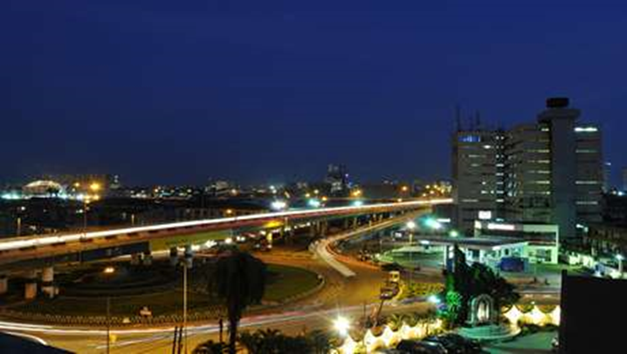
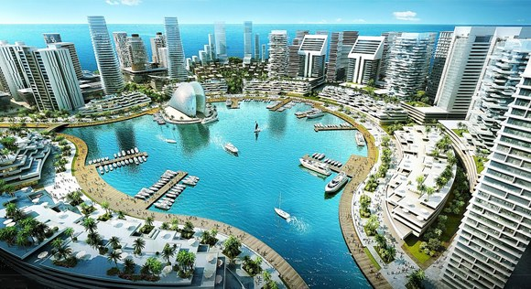
Cairo

Slide 9
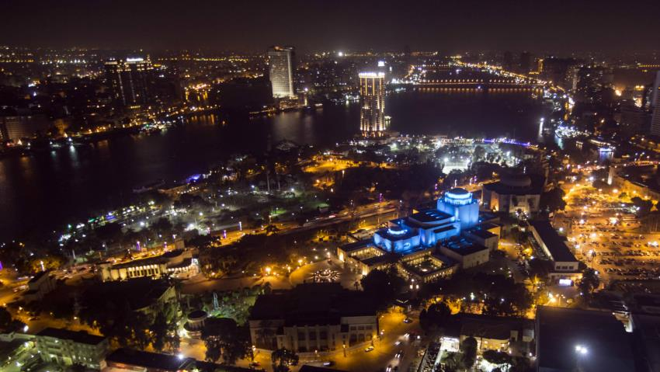
Kinshasa

Slide 10
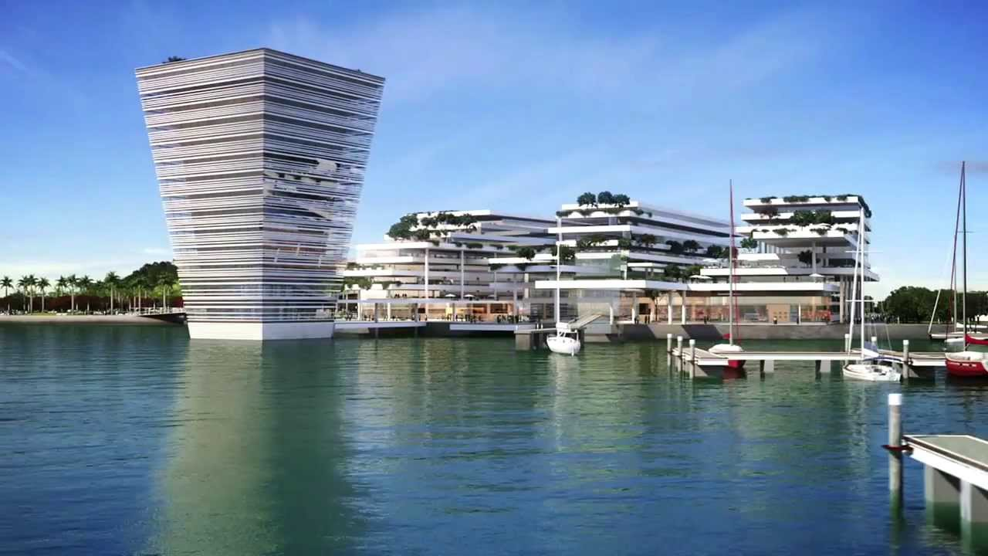
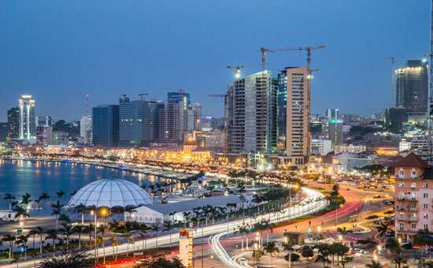
Luanda

Slide 11
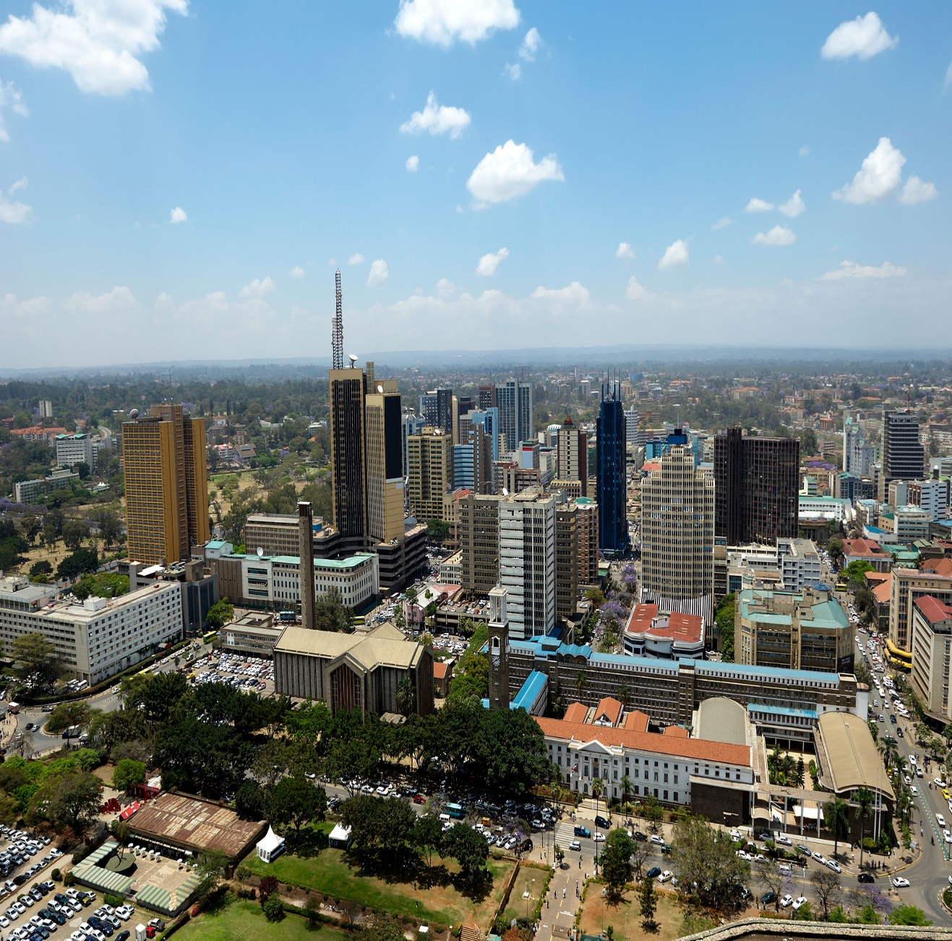
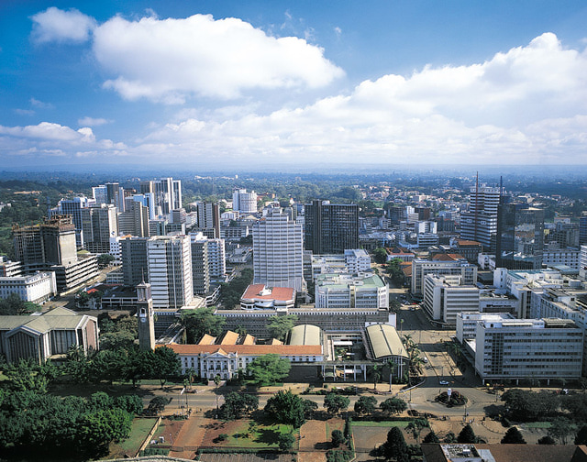
Nairobi

Slide 12
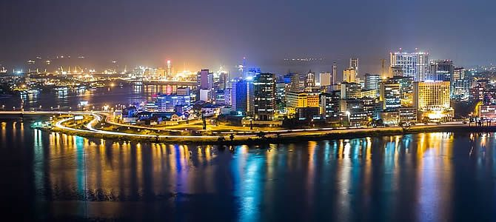
Abidjan

Slide 13
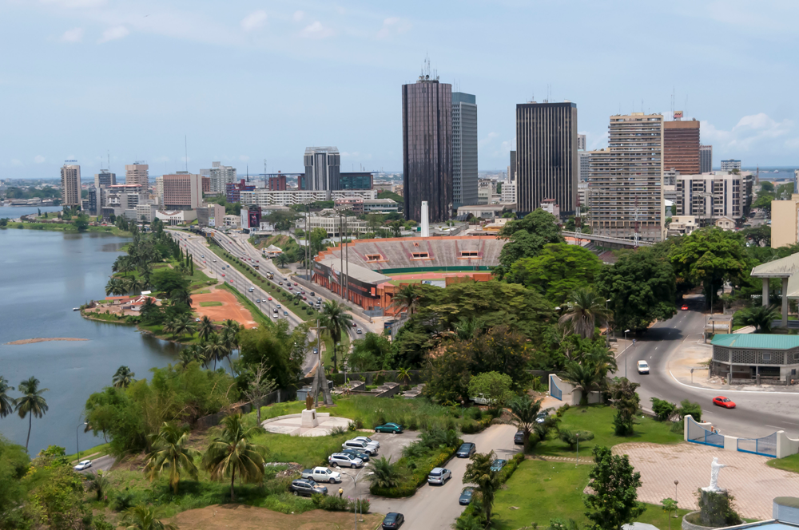
Abidjan

Slide 14
Economy
Resource rich continent
Economy consists of trade, industry, agriculture and human resources
Recent growth due to growth in sales in commodities, services and manufacturing
Sub-Saharan Africa expected to reach a GDP of 23 trillion in 2050
In march 2013, identified as the world poorest continent, GDP barely a 1/3 of the USA

Slide 15
Economy
According to the world bank, most African countries will reach middle income status by 2025 if currents growth rates continue
In 2013, the world fastest growing continent at 5.6% a year, and GDP is expected to rise by an average of over 6% a year between 2013 and 2023.
In 2017, the African Development Bank reported Africa to be the world’s second-fastest growing economy, and estimates that average growth will rebound to 3.4% in 2017, while growth is expected to increase by 4.3% in 2018.

Slide 16
Economy
Growth has been present throughout the continent, with over one-third of Sub-Saharan African countries posting 6% or higher growth rates, and another 40% growing between 4% to 6% per year
International business observers have also named Africa as the future economic growth engine of the world.

Slide 17
Economy
# | Country | GDP (2017, IMF)
1 | Nigeria | $376.3 billion
2 | South Africa | $349.3 billion
3 | Egypt | $237.1 billion
4 | Algeria | $178.3 billion
5 | Angola | $124.2 billion
6 | Morocco | $109.8 billion
7 | Ethiopia | $80.9 billion
8 | Kenya | $79.5 billion
9 | Sudan | $58.2 billion
10 | Tanzania | $51.7 billion

Slide 18
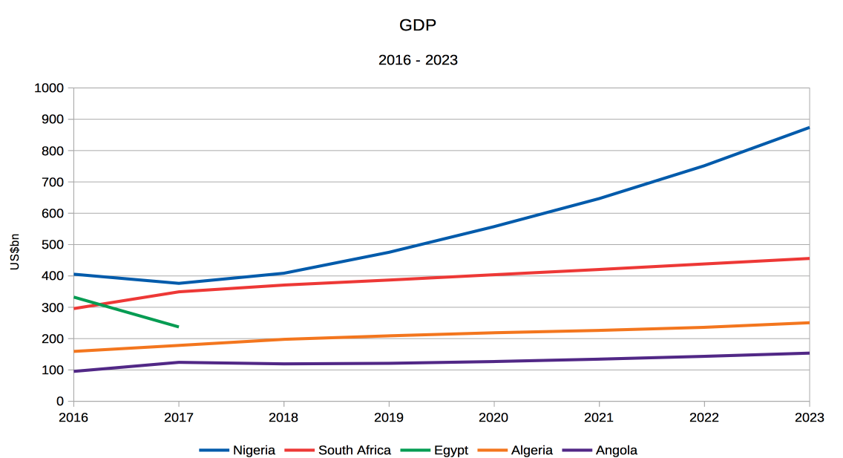
Economy

Slide 19
Economy
# | Country | GDP per capita (2017, IMF)
1 | Mauritius | $9 794
2 | Gabon | $7 971
3 | Botswana | $7 877
4 | South Africa | $6 179
5 | Namibia | $5 413
6 | Libya | $4 858
7 | Angola | $4 407
8 | Algeria | $4 292
9 | Swaziland | $3 914
10 | Tunisia | $3 496

Slide 20
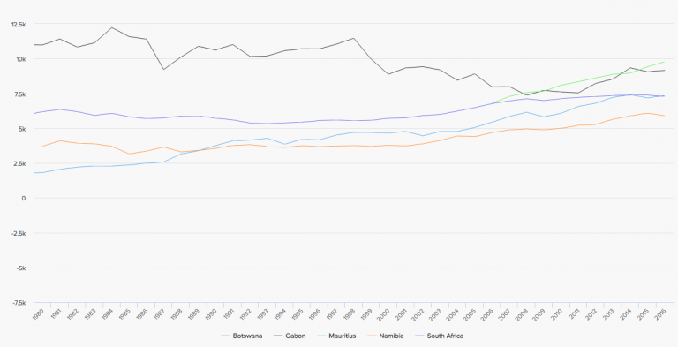
Economy

Slide 21
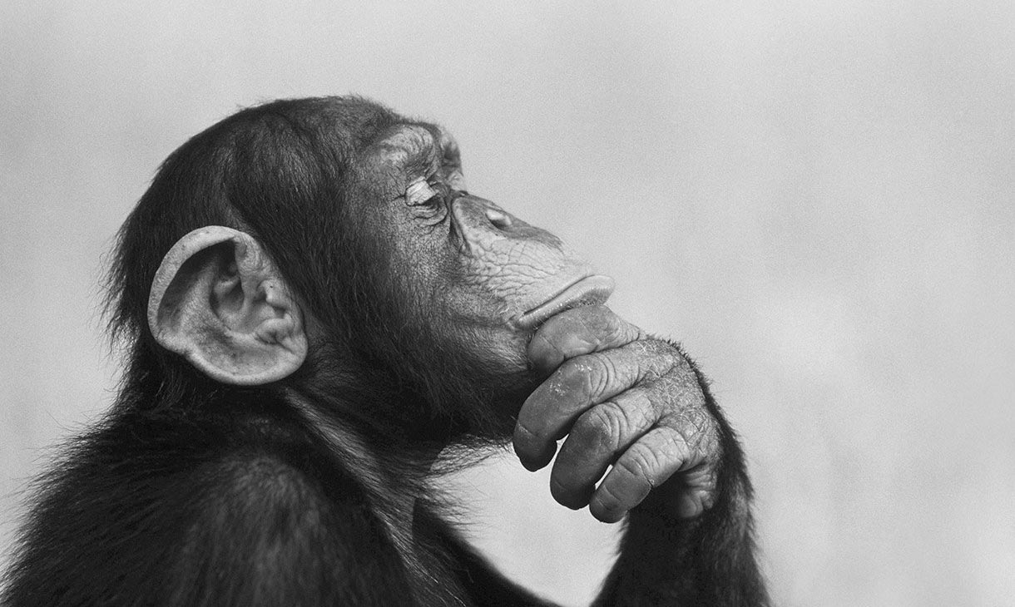
Perceptions of Africa
Africa ???
Notes:
The danger of a single story : https://www.ted.com/talks/chimamanda_adichie_the_danger_of_a_single_story

Slide 22
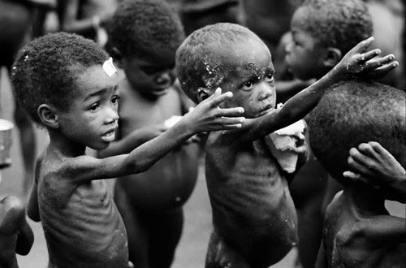
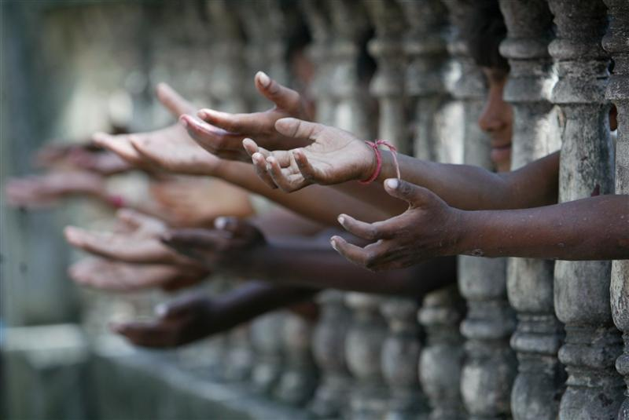
Perceptions of Africa
Poor

Slide 23
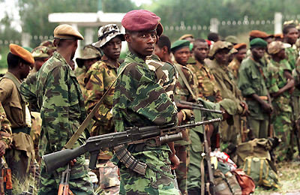
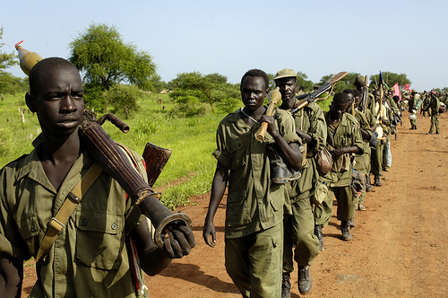
Perceptions of Africa
WAR
WAR

Slide 24
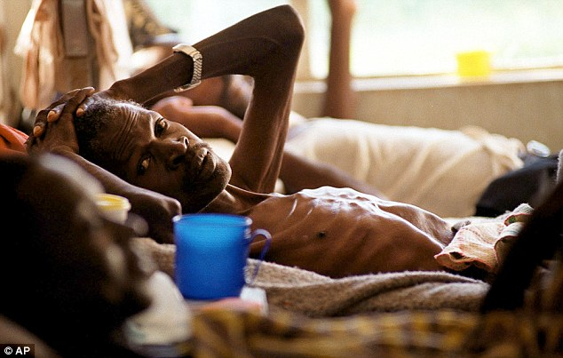
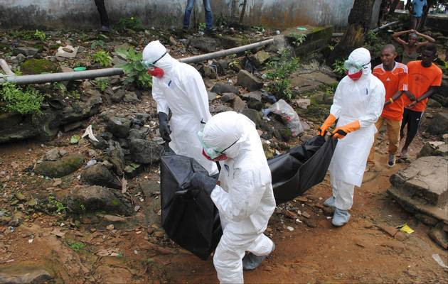
Perceptions of Africa
Disease

Slide 25
Perceptions of Africa
Rene Dumont（1962）Africa has gotten off of a “bad start related all the negative aspects” facing newly independent African states.
In the mainstream “western media”, Africa is usually portrayed and described at the image of the four horsemen of the apocalypse : war, disease famine and poverty.
Narratives have overshadowed the underpinning causes

Slide 26
Africa’s Underdevelopment
Colonization
Formation of the Africa States
Balkanization of Africa in different states
Neo-colonialism
Interventions
Foreign Aid
Resource Curse
Terrorism

Slide 27
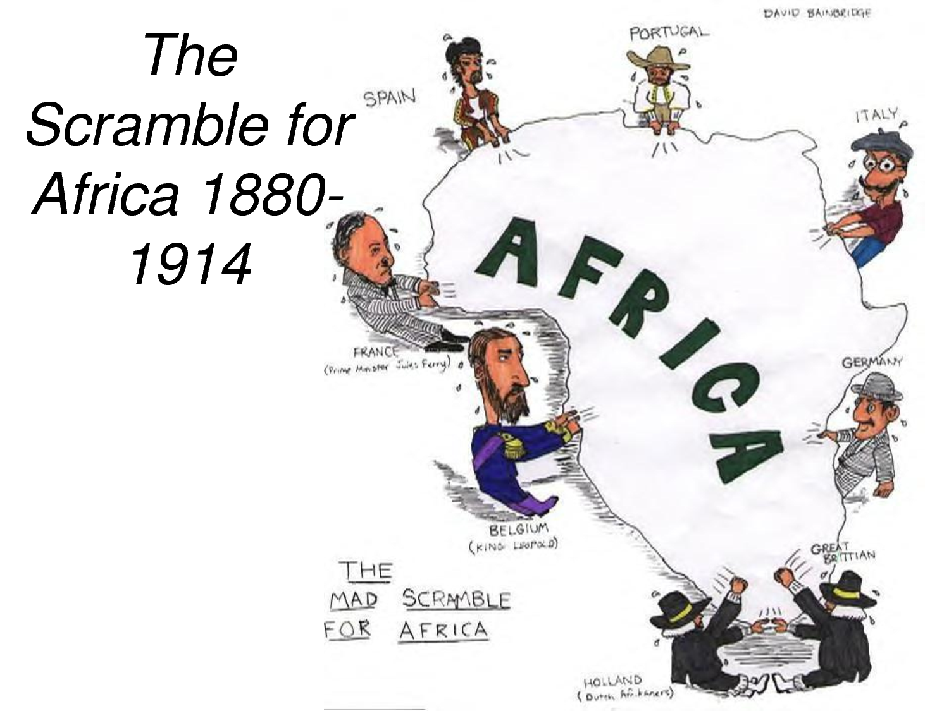
Colonization

Slide 28
Colonization
19th century
Scramble for Africa
Economic, political and social reasons
Africa could be an opened market that will garner western powers a trade surplus (protectionist continental Europe market due to the long depression 1876-93)
Limited competition, abundant raw material
Supply the high demand of unavailable raw material in Europe
Cultural, political colonization
Destabilization of the traditional social order

Slide 29
Formation of the Africa States
Independences in 1960s
Artificially created states with multiple ethnicities
Former kingdoms
Colonial legacies (some ethnic groups were favored)
Civil wars
E.g : Nigeria (Biafran war), Somalia, Burundi, Rwanda
Notes:
0s

Slide 30
Balkanization of Africa
Fragmentation of Africa into small states
No consideration of social organizations
Territorial conflicts between States
States interfering with neighbors internal conflicts
E.g : Rwanda in Democratic Republic of Congo, Burkina Faso in Ivory Coast, etc

Slide 31
Neo-colonialism
Continued economic, political and cultural ties with former colonies
Interference with former colonies internal policies
Foreign capital used for the exploitation of newly independent countries rather for the development of African countries.
Support of corrupted leaders during the cold war (realpolitik)
Francafrique (relation between France and its former colonies)
Francois-Xavier Verschave, La Francafrique le plus long scandale de la Republique (1999)

Slide 32
External Interferences
Military interventions to support or overthrow a leader (geopolitical goals)
E.g : Zaire (actual DRC), Chad(2005), Ivory Coast (2010), Libya (2011)
Negative consequences on peace between communities
Negative economic and political impacts
Impacts on neighboring countries (Libya-Mali; Cote d’Ivoire-Burkina Faso)

Slide 33
Foreign Aid
Aid to Africa has reached 1 trillion (50 years)
10-13% of budget
Aid is not invested in growth related activities and productive sectors (Dambisa Moyo)
Poverty relief, end of famine, etc
Countries develop through investments, trade entrepreneurship not by relying on handouts
E.g of positive impact of aid: actual engagement between China and Africa.

Slide 34
Resource Curse
Paradox of the plenty
Abundance of natural resources (fossil fuel, minerals) lead to less economic growth, less democracy, worse development outcomes.
Corruption, Nepotism, dictatorship
Democratic Republic of Congo

Slide 35
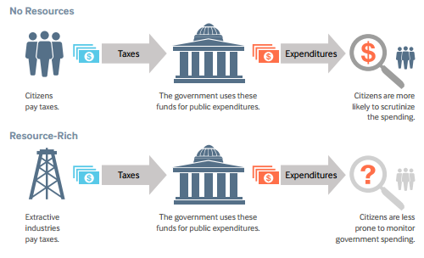
Resource Curse

Slide 36
Terrorism
Growing presence of terror groups in the Continent
Undermine development, foreign investment, tourism, development. Etc
Boko Haram in Nigeria
Al Shahab in Somalia
Al Qaeda affiliates groups all over the region

Slide 37
Conclusion
Education
Technology transfer
Integrate into the world system
Learn from the successful cases of former developing countries
Young population
Entrepreneurial spirit and optimistic

Slide 38
Thank you

